Slide 1
PROJECTION OF PLANES (Sketchbook Problems)

Slide 2
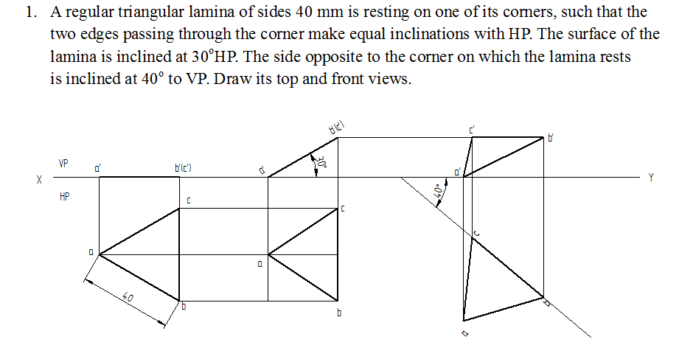

Slide 3
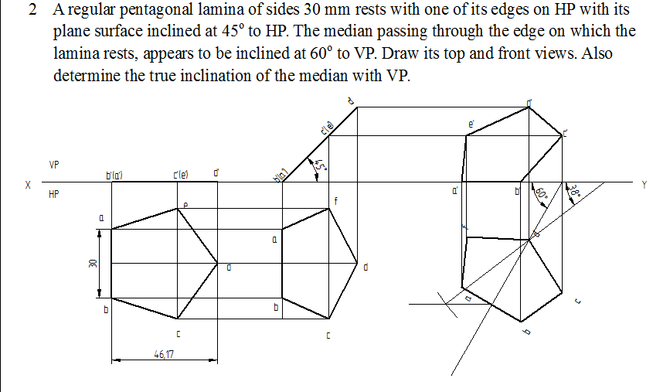

Slide 4
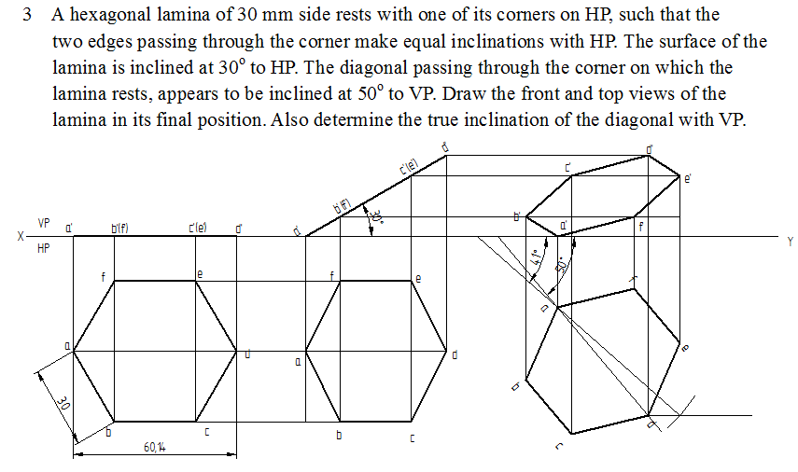

Slide 5
